Slide 1
Test technical development & query
Created By: Abastian Dwi Saputra

Slide 2
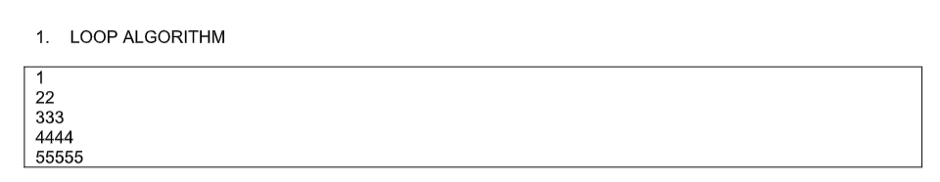
Soal test 1 - development
SOAL NOMOR 1

Slide 3
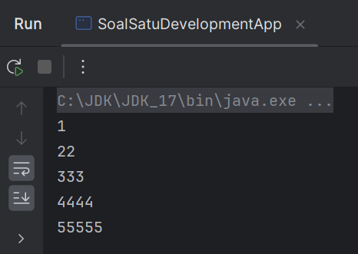
Jawaban test 1 - development
JAWABAN NOMOR 1

Slide 4
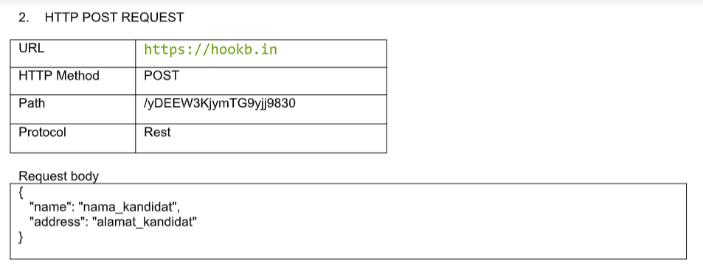
Soal test 1 - development
SOAL NOMOR 2

Slide 5
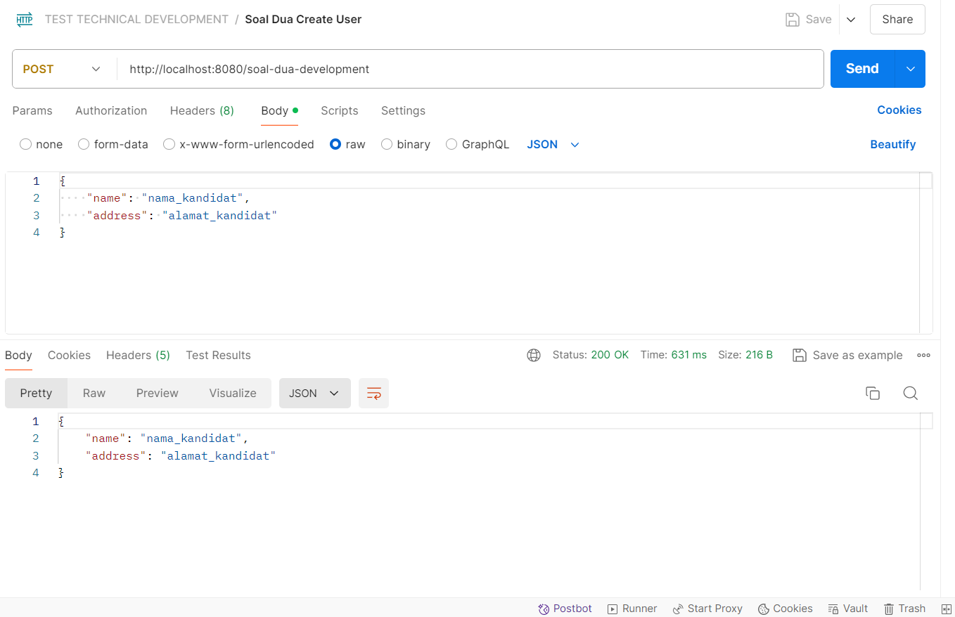
Jawaban test 1 - development
JAWABAN NOMOR 2

Slide 6
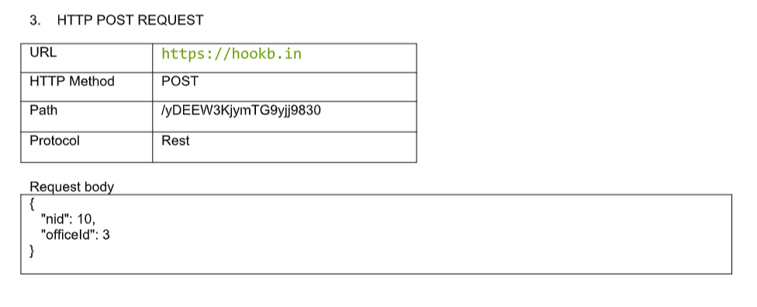
Soal test 1 - development
SOAL NOMOR 3

Slide 7
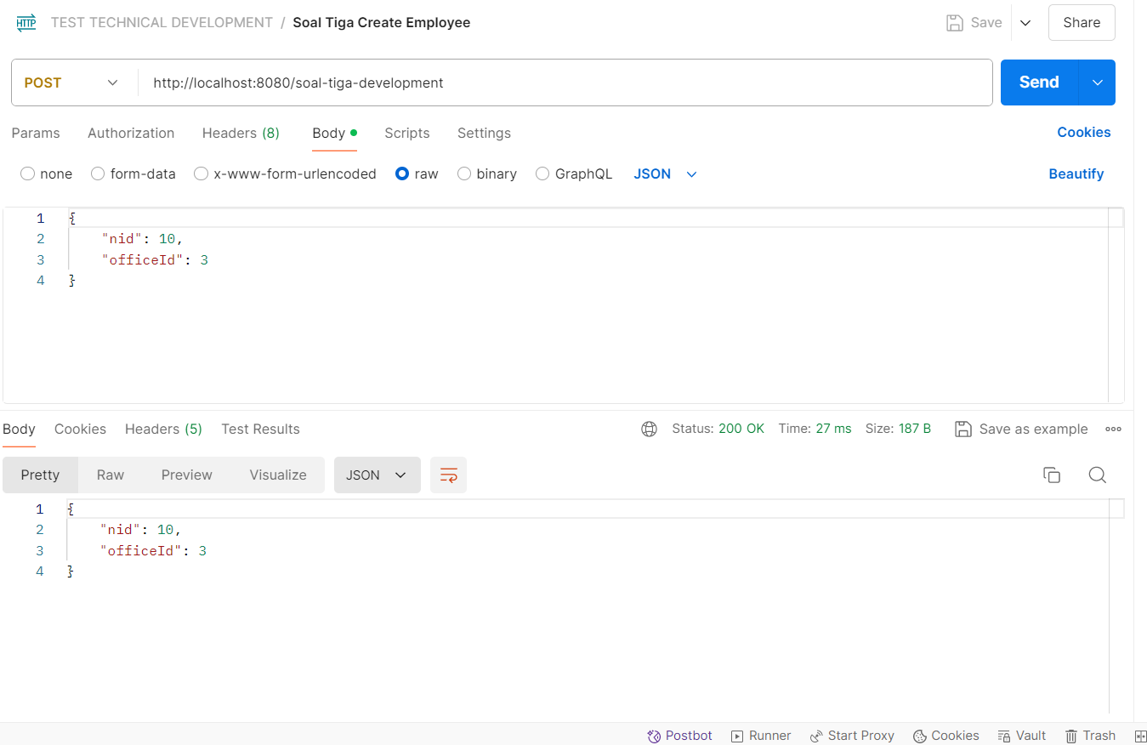
Jawaban test 1 - development
JAWABAN NOMOR 3

Slide 8
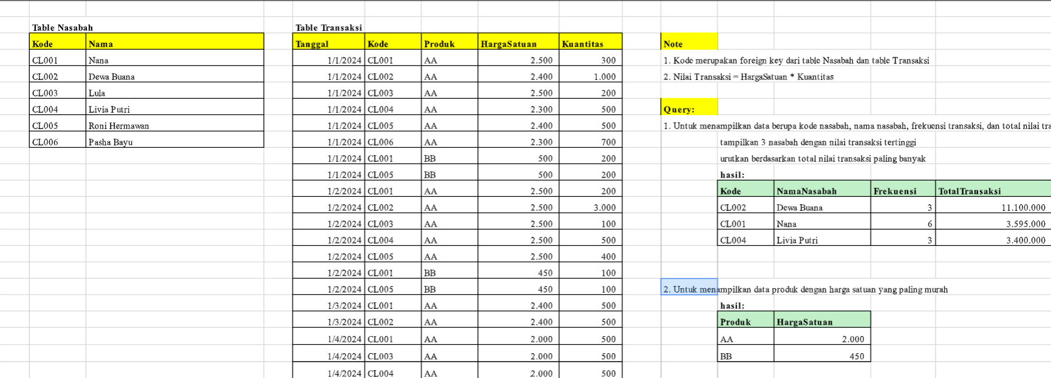
Soal test 2 - QUERY

Slide 9
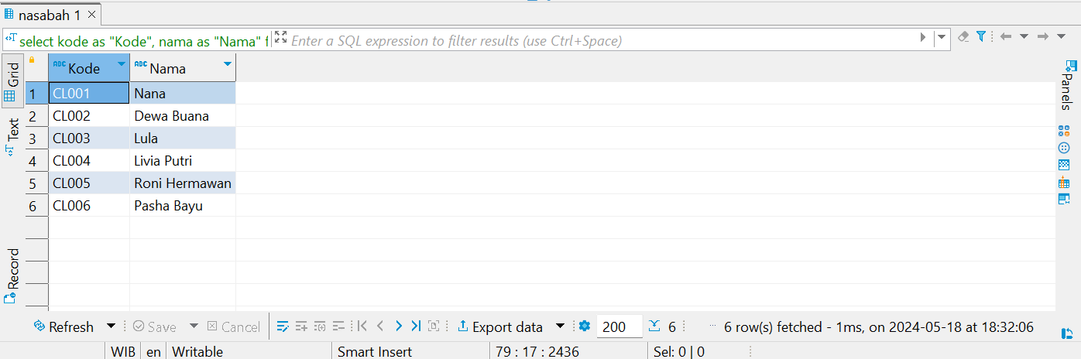
Jawaban test 2 - QUERY
TABLE NASABAH

Slide 10
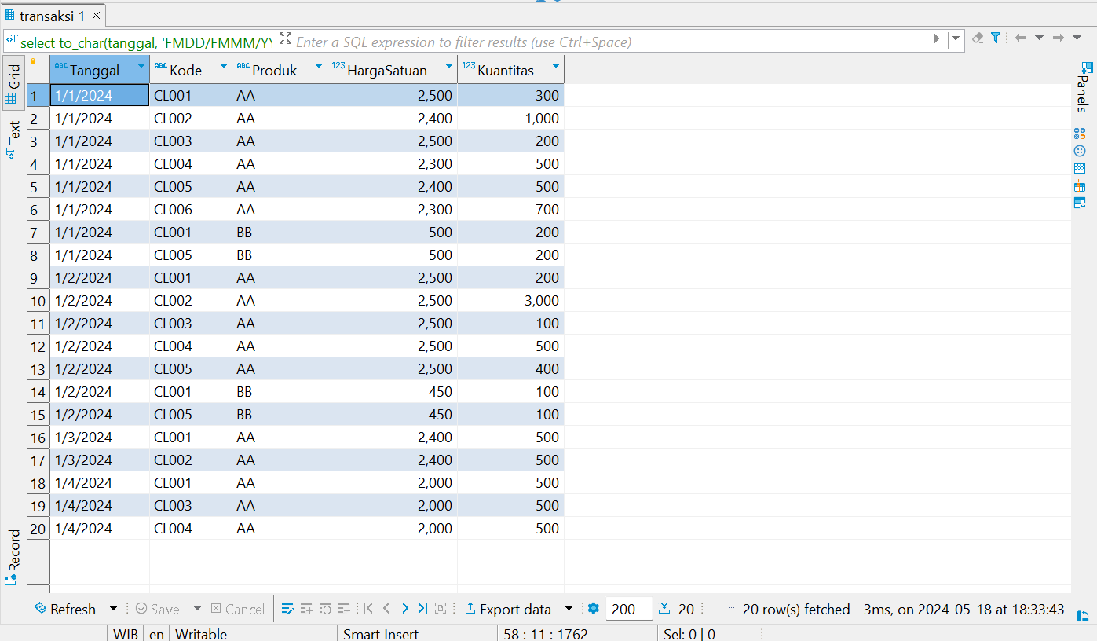
Jawaban test 2 - QUERY
TABLE TRANSAKSI

Slide 11
Jawaban test 2 - QUERY
SOAL NOMOR 1

Slide 12
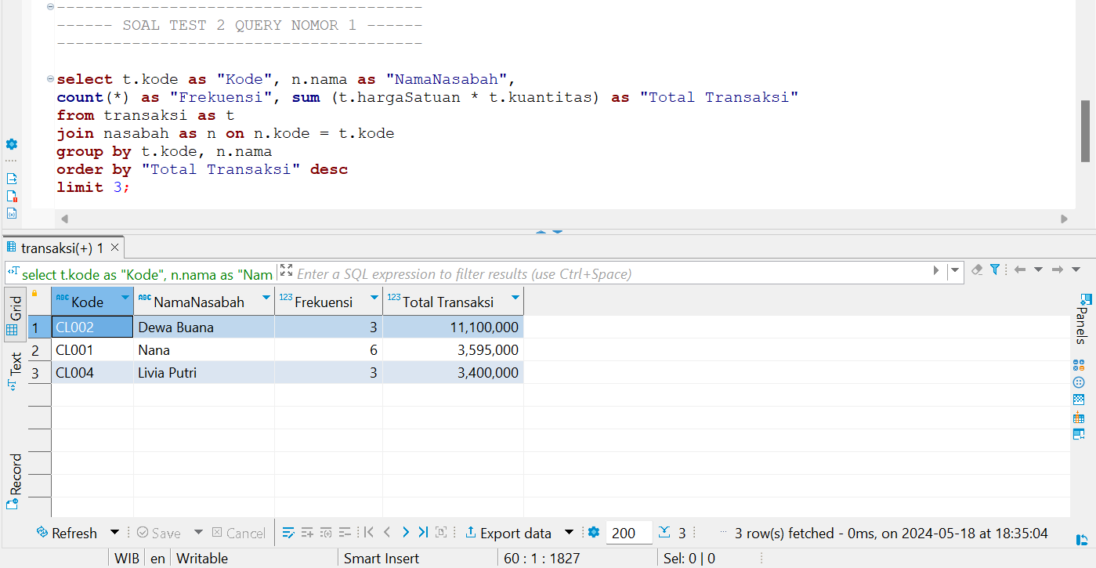
Jawaban test 2 - QUERY
JAWABAN NOMOR 1

Slide 13
Jawaban test 2 - QUERY
SOAL NOMOR 2

Slide 14
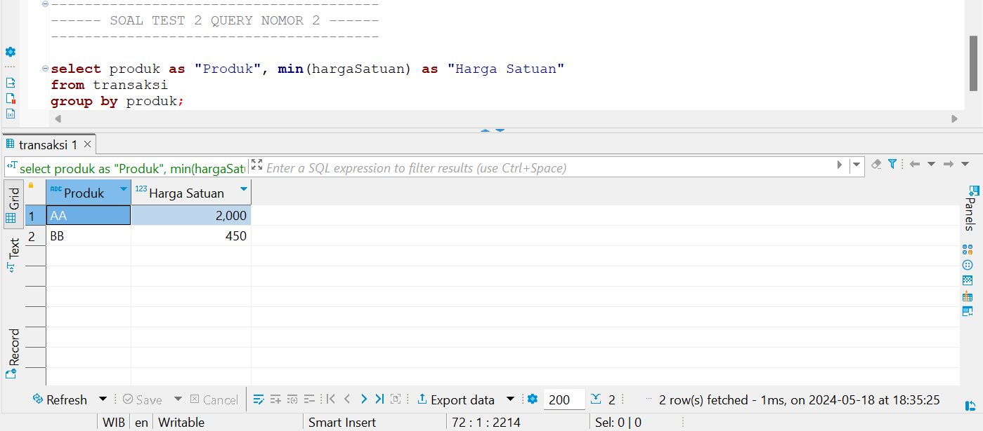
Jawaban test 2 - QUERY
JAWABAN NOMOR 2

Slide 15
SEKIAN DAN TERIMA KASIH

